Slide 1
Embedded Software Engineering
Exercise - 01
Nikhil Ganapathy Manjapura

Slide 2
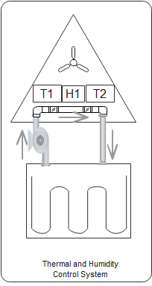
Thermal and Humidity control System
System to maintain ambient environment for cabin crew.
Ideal temperature, humidity and pressure inside the cabin must be maintained for Crew survival.

Slide 3
Characteristics
Hard Real Time System
  Failure of sensor, actuator must be indicated immediately, so that further action can be taken.
Reactive System and real time system
  Based on sensor input alter fan and coolant pump speeds. Reactive to the inner environment of the cabin.
Continuous Systems
  Sensor and actuators parameters must be monitored, used in control logic and to be stored in the memory for further analysis continuously.

Slide 4
Dependable System
  Entire system depends on sensor and actuator parameters threshold.
  Emergency stop button to stop the mission.
Distributed Systems
  Following operations must be distributed.
  Monitoring
  Control logic/algorithm
  Memory Management

Slide 5
Thank You

